Slide 1
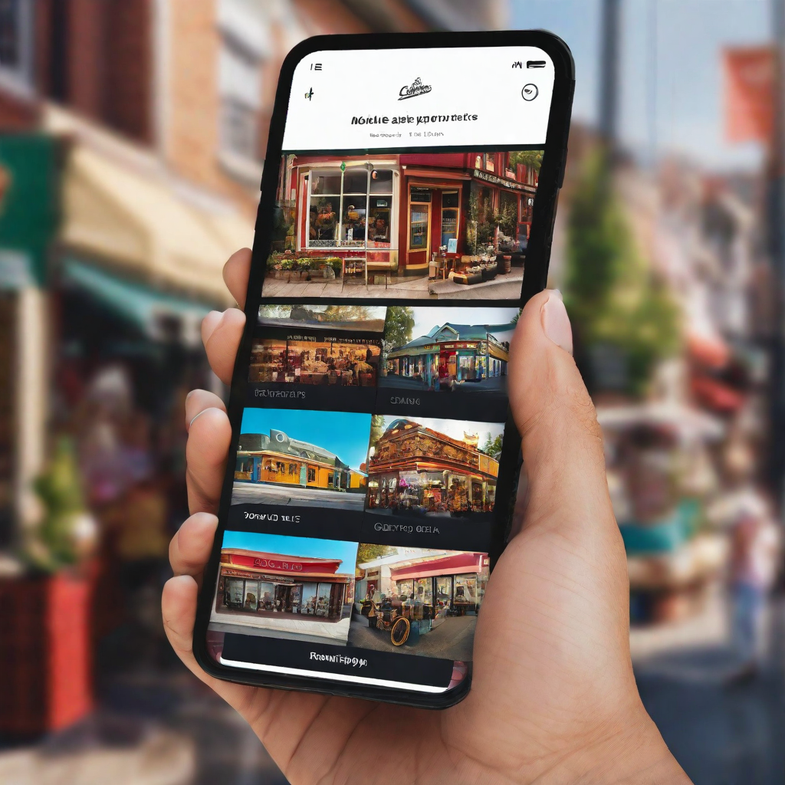
Quecto:
Revolutionizing
Local Commerce

Slide 2

Residents in apartments often face challenges in accessing local shops and services due to busy schedules, lack of transportation, and limited knowledge of the neighborhood.
Local shops struggle to reach potential customers who may not be aware of their offerings. This disconnect results in missed opportunities for both residents and local businesses.
Problem Statement

Slide 3
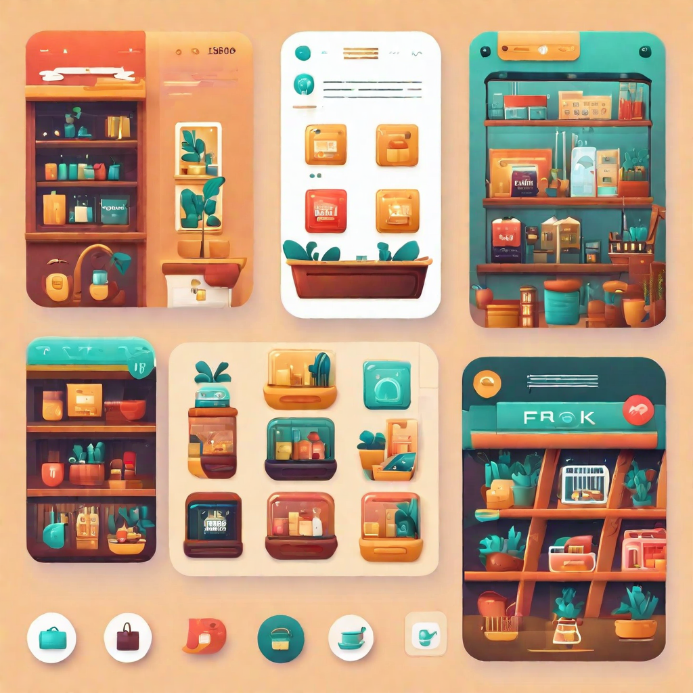
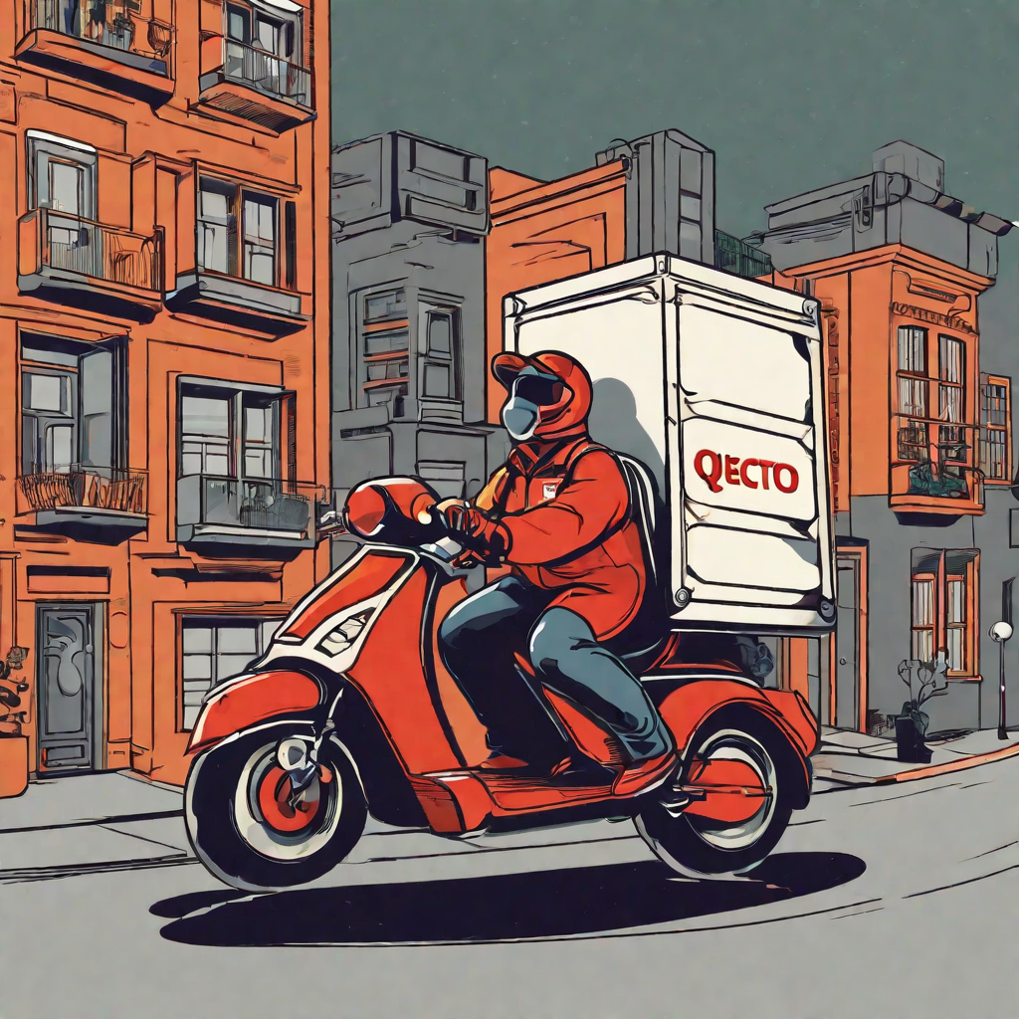
The Quecto Solution
Quecto is a mobile app that connects residents in apartments with local shops, providing a seamless shopping experience.
Benefits for Residents
Convenient access to local shops from the comfort of their home. Easy and fast delivery of groceries and other essentials with ability to support local businesses
Bnaging it themselves
Access to valuable enefits for Local Shops
Increased visibility and customer base
Opportunity to offer delivery services without the hassle of macustomer data and insights

Slide 4
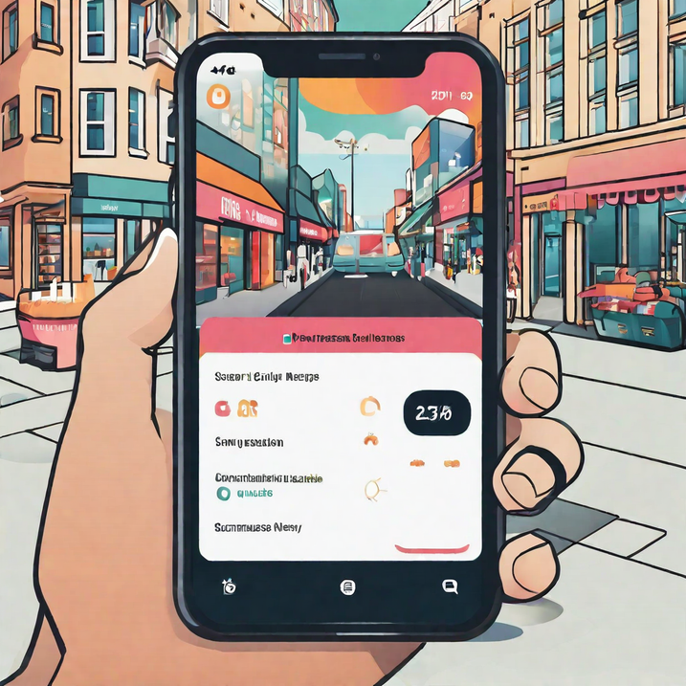
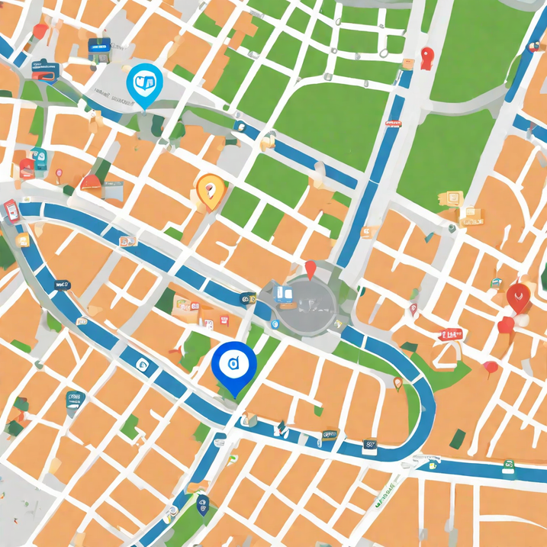
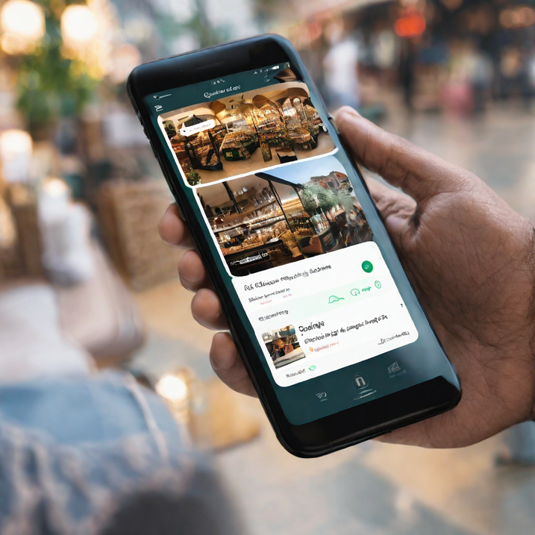
Key Features
Shop Directory
Quecto's platform connects residents in apartments with local shops through a mobile app. The app features a shop directory that allows users to browse local shops and view their deals.
Map Feature
Quecto's map feature shows nearby shops and their deals, making it easy for residents to discover new places to shop and save money.
Chat Feature
Quecto's chat feature allows residents to communicate with local shops directly through the app, making it easy to ask questions, place orders, and get personalized recommendations.

Slide 5
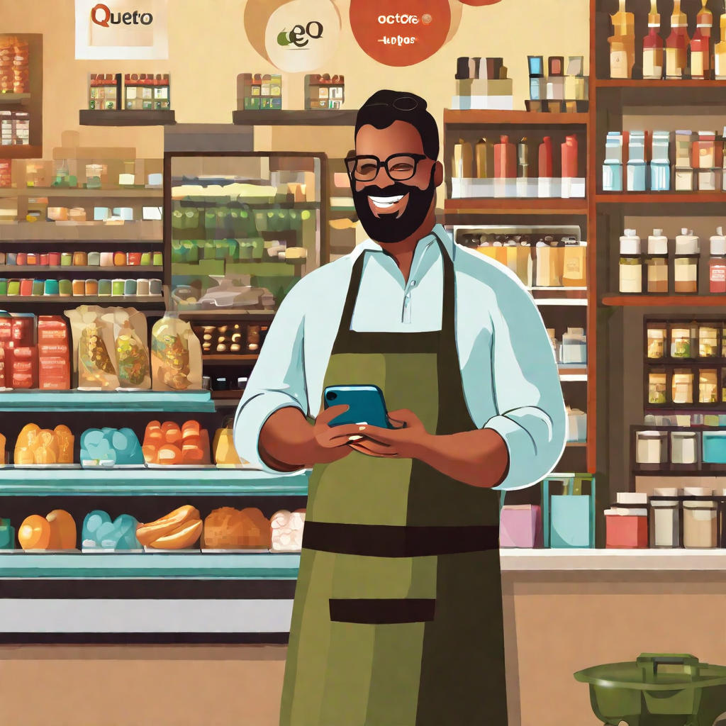
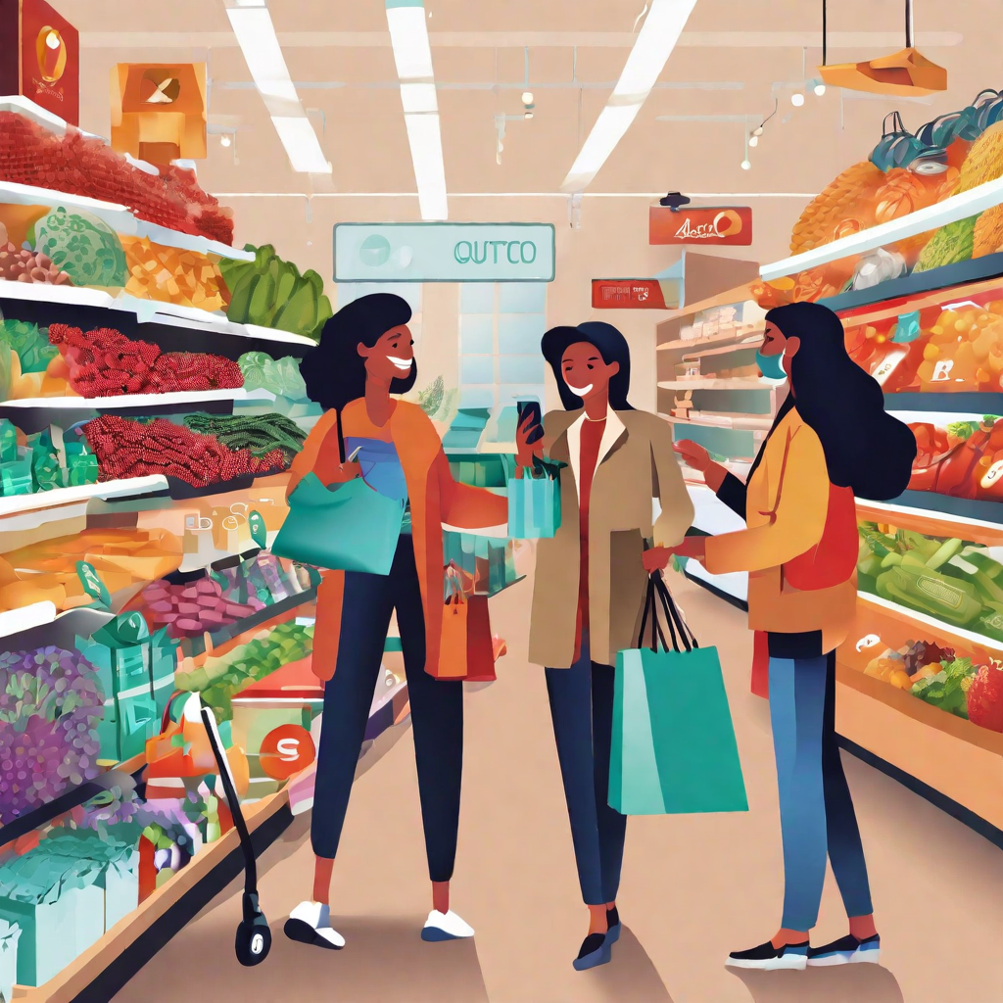
Subscription Model
Quecto offers a subscription model for local shops to join the platform and connect with residents in nearby apartments.
Encouraging Shopkeepers to Join
Quecto offers a low-cost subscription model for local shops to join the platform and reach a wider audience of nearby residents.
Shopkeepers can create their own online store within the app, making it easier for residents to discover and purchase their products.Quecto also provides marketing support and analytics to help shops grow their business through the platform.By joining Quecto, shops can tap into a new customer base and increase their revenue without the need for expensive marketing campaigns.

Slide 6
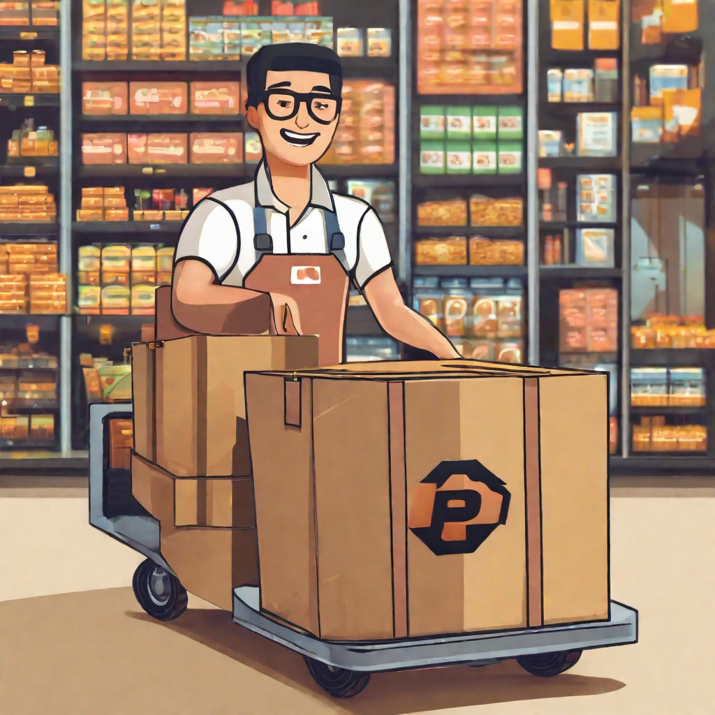
Quickest Delivery with Quecto
Our app sets itself apart from other platforms like BlinkIt or Instamart that have fixed delivery charges for all orders, by allowing each shop to determine its own unique delivery fee.
The fee is influenced by the competitive market in the area, so shops are incentivized to offer lower delivery charges while also ensuring prompt delivery as reviewed by customers.
When delivery charges are competitive, shops strive to provide quick and efficient deliveries, resulting in an ecosystem where businesses continually focus on providing speedy service.
As a result, it fosters a highly efficient marketplace where businesses are consistently motivated to deliver swiftly and efficiently.

Slide 7
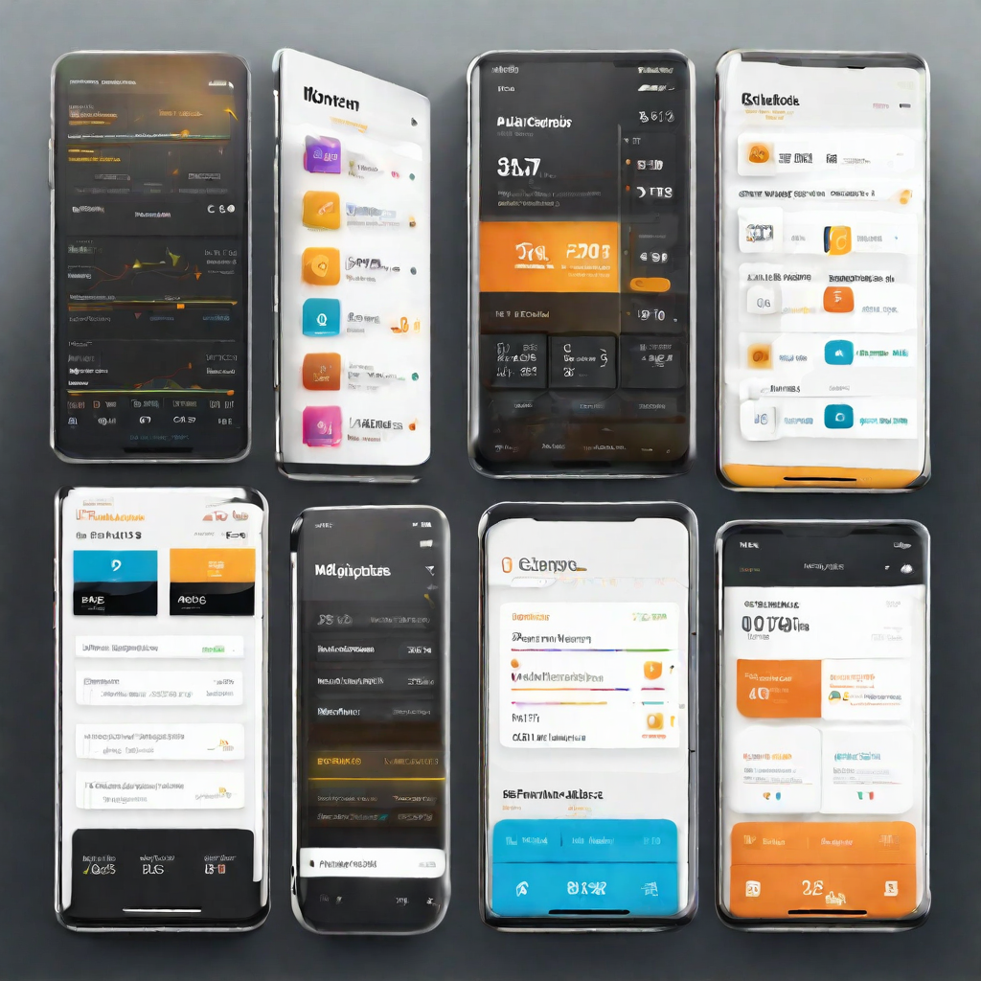
Technology Behind Quecto
Quecto's platform is built on cutting-edge technology that seamlessly connects residents in apartments with local shops through a mobile app. Our technology stack includes:
React Native / Flutter for cross-platform mobile app development, ensuring a consistent user experience across iOS and Android devices.
Node.js and Express for server-side development, providing a scalable and robust backend infrastructure.
MongoDB for database management, allowing for efficient and flexible data storage and retrieval.

Slide 8

Customer Benefits
Convenience and Time-Saving:
Customers can easily browse and purchase products from local shops through the Quecto mobile app, saving them time and making their shopping experience more convenient.
Access to Unique Products
Quecto's platform allows customers to discover and purchase unique products from local shops that they may not have been able to find otherwise, providing them with a more diverse shopping experience.
Supporting Local Businesses
By using Quecto's platform, customers are directly supporting local businesses in their community. This helps to strengthen the local economy and promote sustainable growth.

Slide 9
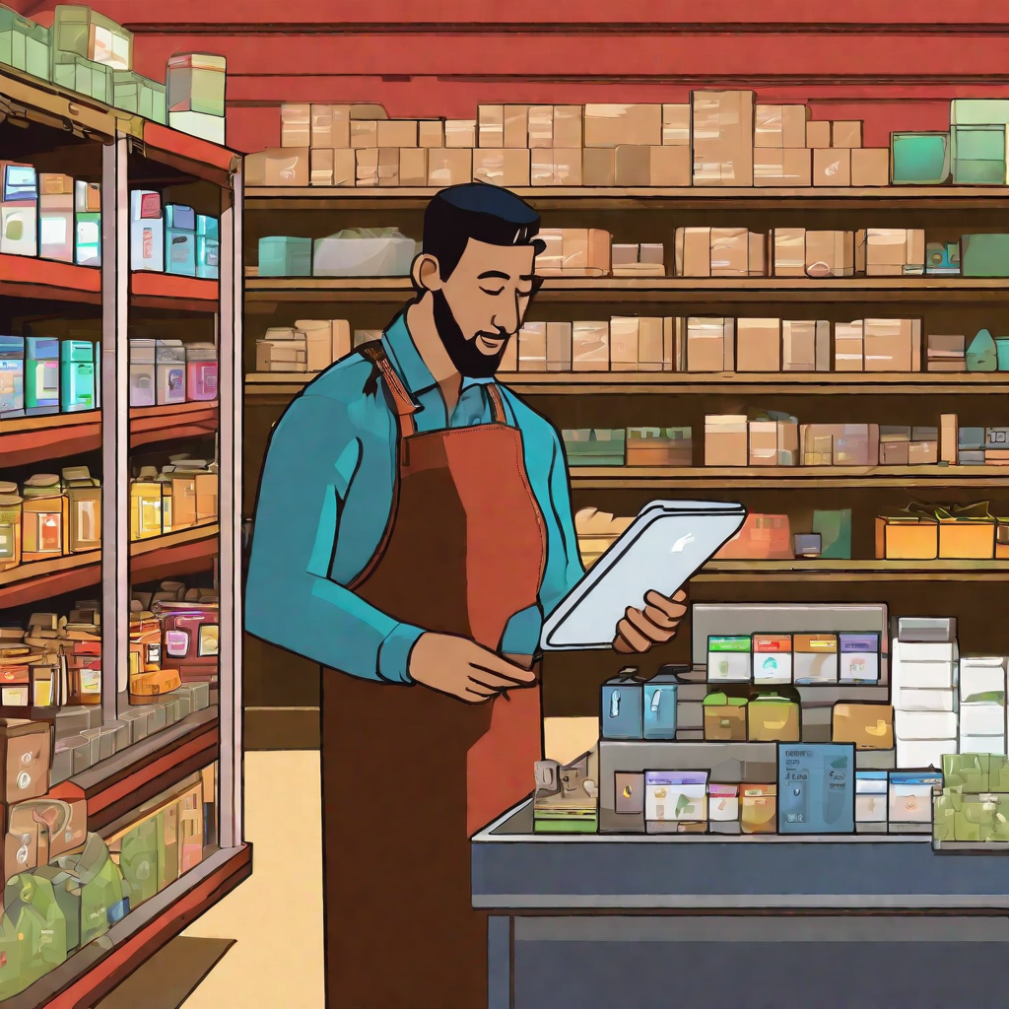
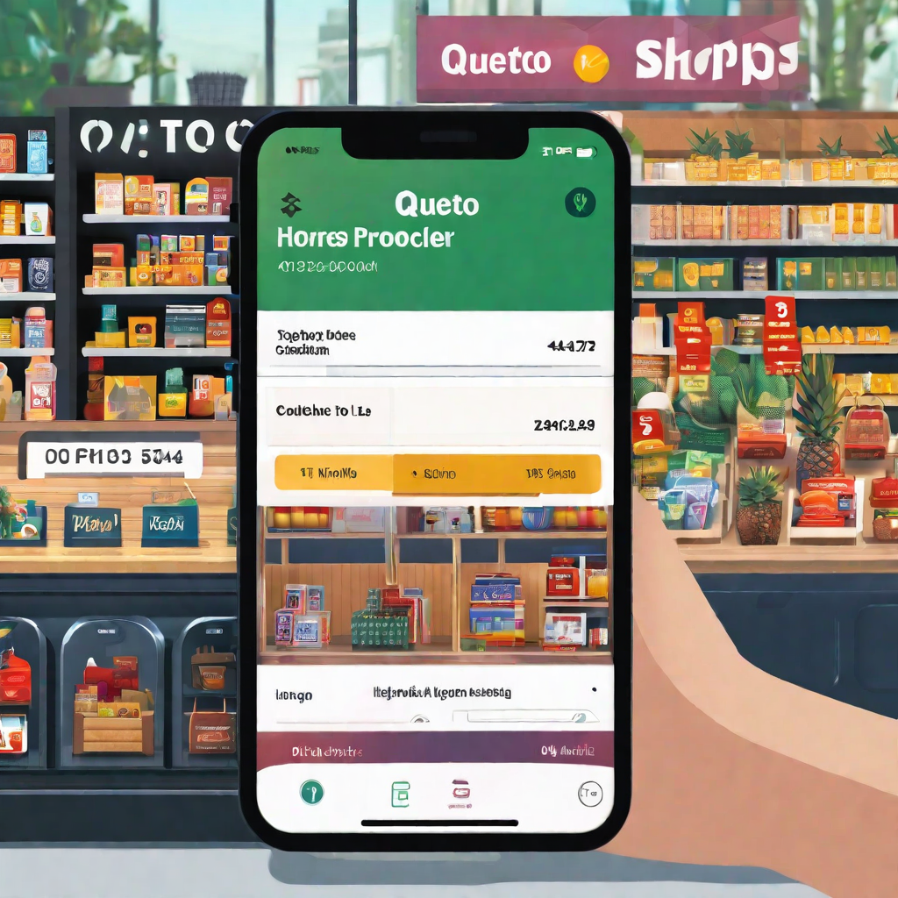
Business Benefits
Increased Visibility
By joining Quecto's platform, businesses gain increased visibility and exposure to potential customers in their local community
Streamlined Operations
The Quecto app allows businesses to easily manage their inventory, orders, and customer interactions all in one place, streamlining their operations and saving time.

Slide 10

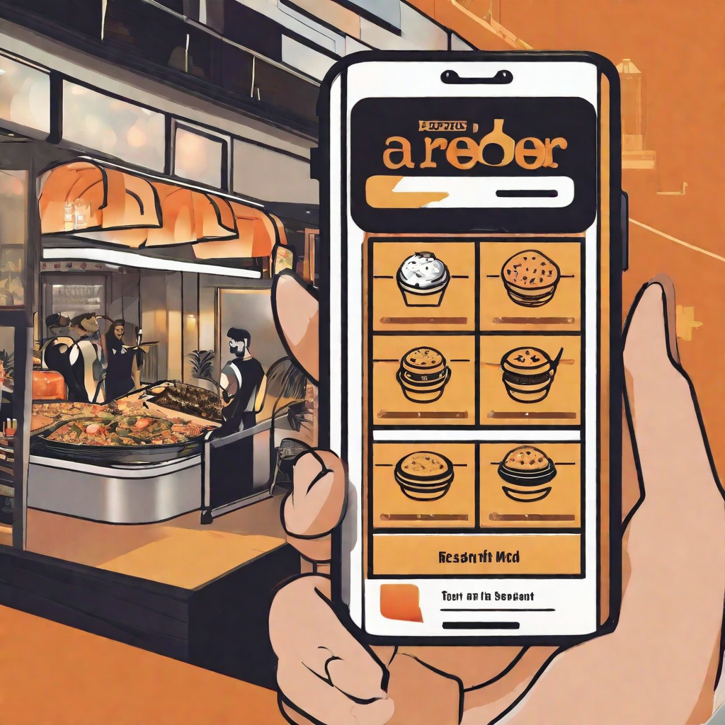

Market Potential
Quecto's platform has immense market potential, as it addresses the growing need for convenience and community in urban living. With more and more people living in apartments and relying on mobile apps for daily tasks, Quecto offers a unique solution that connects residents with local shops and services.
Growing Urban Population
As the world's population continues to grow and urbanize, more people are living in apartments and relying on mobile apps for daily tasks. Quecto's platform addresses this trend by providing a convenient way for residents to connect with local shops and services.
Increasing Demand for Convenience
In today's fast-paced world, people are increasingly looking for convenient solutions that save them time and effort. Quecto's platform offers a one-stop-shop for residents to access local shops and services, making their lives easier and more efficient.
Building Community
Quecto's platform not only provides convenience, but also helps to build community by connecting residents with local shops and services. This creates a sense of belonging and encourages support for local businesses, which is important for the overall health and vitality of urban areas.

Slide 11
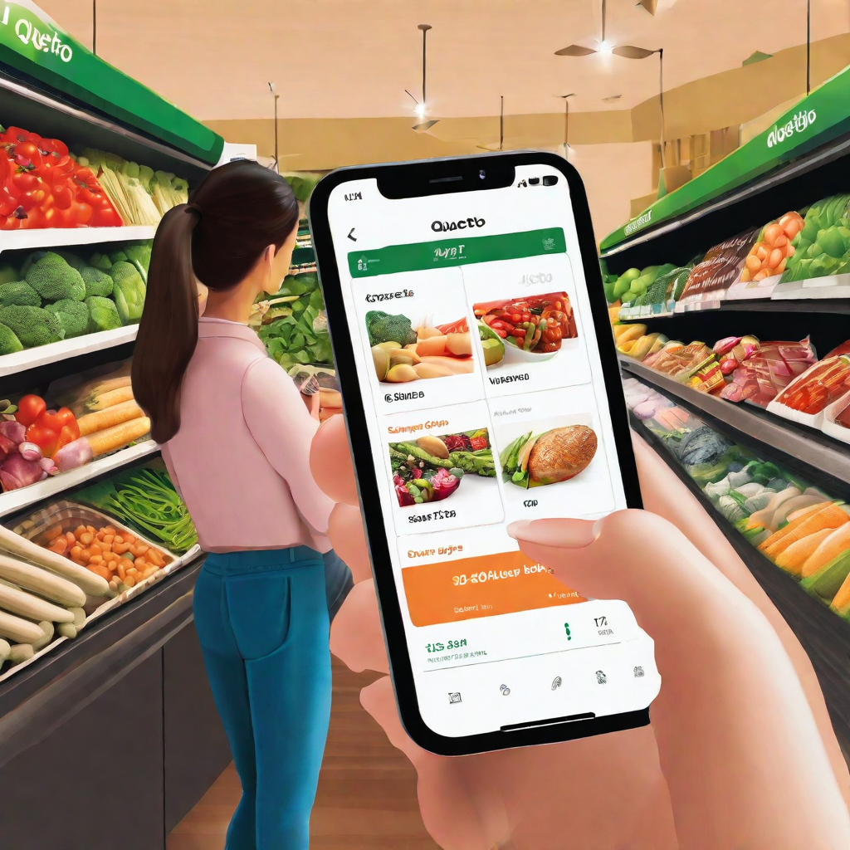
Future Roadmap
Quecto has a bright future ahead with several exciting initiatives in the pipeline.
Expansion to new cities: Quecto plans to expand to several new cities in the next year, bringing the convenience of local shopping to even more residents.
Introducing Pay Later: Quecto will soon enable the option of pay later where the customer can order products anytime and pay later at the end of month.
Expanded product offerings: Quecto will soon offer a wider range of products, including fresh produce, meats, and dairy, making it a one-stop-shop for all of residents' grocery needs.

